Slide 1

Modern Database Management
Thirteenth Edition
Chapter 1
The Database Environment and Development Process
Slides in this presentation contain hyperlinks. JAWS users should be able to get a list of links by using INSERT+F7
Copyright © 2019, 2016, 2013 Pearson Education, Inc. All Rights Reserved

Slide 2
Learning Objectives (1 of 2)
1.1 Define terms
1.2 Name limitations of conventional file processing
1.3 Explain advantages of databases
1.4 Identify costs and risks of databases
1.5 Distinguish between operational and informational data management
1.6 List components of database environment

Slide 3
Learning Objectives (2 of 2)
1.7 Identify categories of database applications
1.8 Explain prototyping and agile development approaches
1.9 Explain roles of individuals
1.10 Explain differences between personal, multi-tiered, and enterprise data management
1.11 Explain three-schema architectures (external, conceptual, internal)

Slide 4
Definitions
Database: organized collection of logically related data
Data: stored representations of meaningful objects and events
Structured: numbers, text, dates
Unstructured: images, video, documents
Information: data processed to increase knowledge in the person using the data
Metadata: data that describes the properties and context of user data

Slide 5
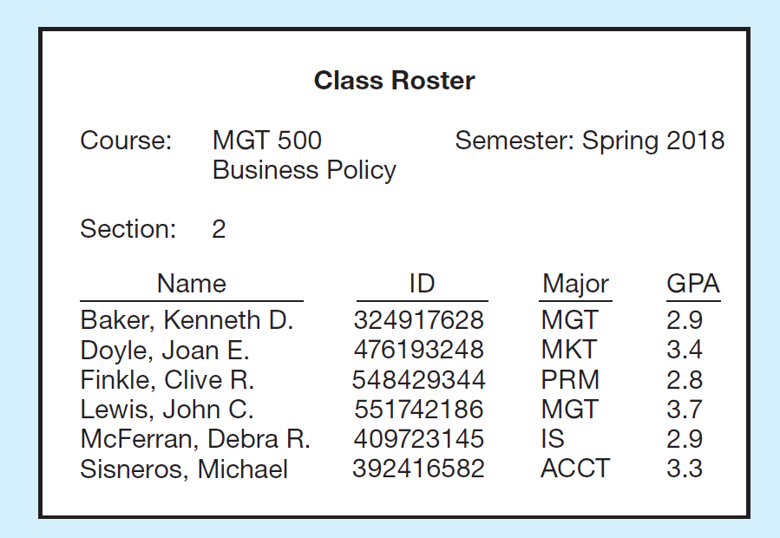
Figure 1-1 Converting Data to Information (1 of 2)
(a) Data in context

Slide 6

Figure 1-1 Converting Data to Information (2 of 2)
(b) Summarized data
Graphical displays turn data into useful information that managers can use for decision making and interpretation

Slide 7
Table 1-1 Example Metadata for Class Roster
Descriptions of the properties or characteristics of the data, including data types, field sizes, allowable values, and data context
Data Item
Metadata
Name | Type | Length | Minimum | Maximum | Description | Source
Course | Alphanumeric | 30 | Blank | Blank | Course I D and name | Academic Unit
Section | Integer | 1 | 1 | 9 | Section number | Registrar
Semester | Alphanumeric | 10 | Blank | Blank | Semester and year | Registrar
Name | Alphanumeric | 30 | Blank | Blank | Student name | Student I S
I D | Integer | 9 | Blank | Blank | Student I D (S S N) | Student I S
Major | Alphanumeric | 4 | Blank | Blank | Student major | Student I S
G P A | Decimal | 3 | 0.0 | 4.0 | Student grade point average | Academic Unit

Slide 8
Disadvantages of File Processing
Program-Data Dependence
All programs maintain metadata for each file they use
Duplication of Data
Different systems/programs have separate copies of the same data
Limited Data Sharing
No centralized control of data
Lengthy Development Times
Programmers must design their own file formats
Excessive Program Maintenance
80% of information systems budget

Slide 9
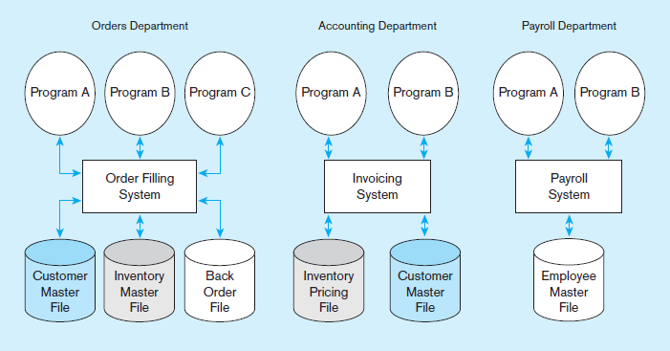
Figure 1-2 Old File Processing Systems at Pine Valley Furniture Company

Slide 10
SOLUTION: The DATABASE Approach
Central repository of shared data
Data is managed by a controlling agent
Stored in a standardized, convenient form
Requires a Database Management System (DBMS)

Slide 11
Database Management System
A software system that is used to create, maintain, and provide controlled access to user databases
Order Filing
System
Central database
Contains employee,
order, inventory,
pricing, and
customer data
Invoicing
System
DBMS
Payroll
System
DBMS manages data resources like an operating system manages hardware resources

Slide 12
The Database Approach (1 of 2)
Data models
Graphical diagram capturing nature and relationship of data
Enterprise Data Model – high-level entities and relationships for the organization
Project Data Model – more detailed view, matching data structure in database or data warehouse
Entities
Noun form describing a person, place, object, event, or concept
Composed of attributes
Relationships
Between entities
Usually one-to-many
or many-to-many
but can also be
one-to-one

Slide 13
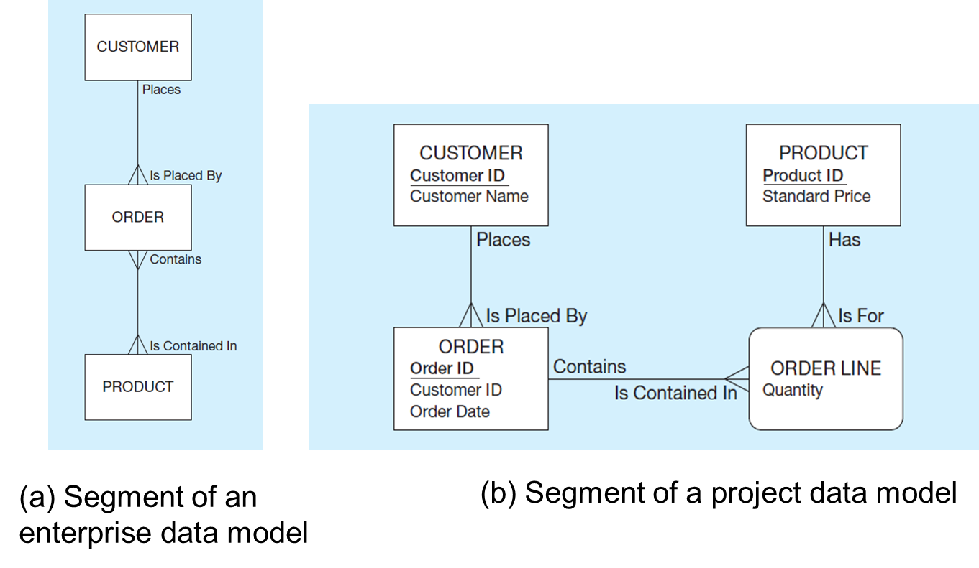
Figure 1-3 Comparison of Enterprise- and Project-Level Data Models
(a) Segment of an enterprise data model
(b) Segment of a project data model

Slide 14
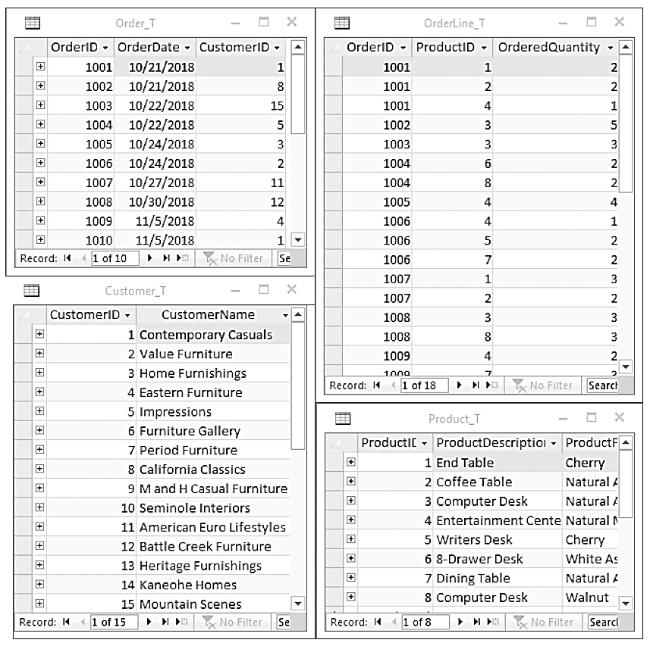
The Database Approach (2 of 2)
Relational Databases
Database technology involving tables (relations) representing entities and primary/foreign keys representing relationships (see Figure 1-17)

Slide 15
Advantages of the Database Approach
Program-data independence
Planned data redundancy
Improved data consistency
Improved data sharing
Increased application development productivity
Enforcement of standards
Improved data quality
Improved data accessibility and responsiveness
Reduced program maintenance
Improved decision support

Slide 16
Costs and Risks of the Database Approach
New, specialized personnel
Installation and management cost and complexity
Conversion costs
Need for explicit backup and recovery
Organizational conflict

Slide 17
Components of the Database Environment
Data modeling and design tools – automated tools used to design databases and application programs
Repository – centralized storehouse of metadata
Database Management System (D B M S) – software for managing the database
Database – storehouse of the data
Application Programs – software using the data
User Interface – text, graphical displays, menus, etc. for user
Data/Database Administrators – personnel responsible for maintaining the database
System Developers – personnel responsible for designing databases and software
End Users – people who use the applications and databases

Slide 18
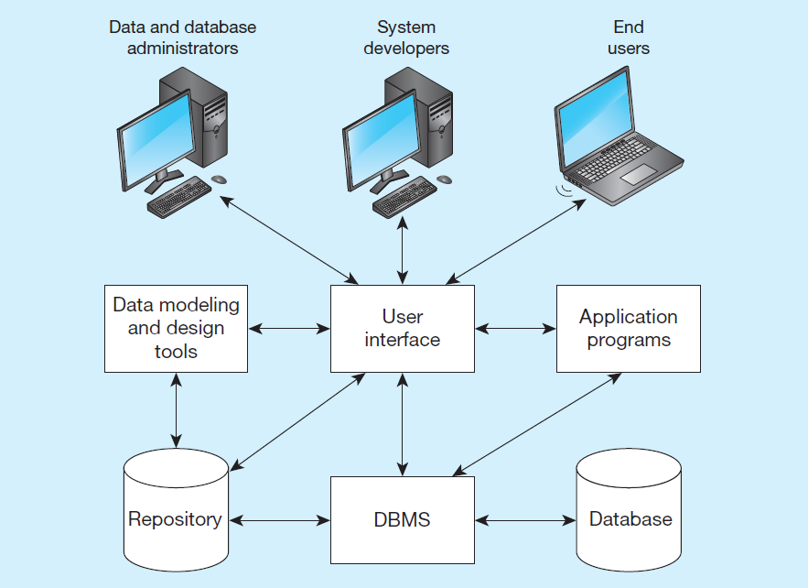
Figure 1-6 Components of the Database Environment

Slide 19
The Database Development Process
S D L C
System Development Life Cycle
Detailed, well-planned development process
Time-consuming, but comprehensive
Long development cycle
Prototyping
Rapid application development (R A D)
Cursory attempt at conceptual data modeling
Define database during development of initial prototype
Repeat implementation and maintenance activities with new prototype versions

Slide 20
Systems Development Life Cycle (S D L C)
The traditional methodology used to develop, maintain, and replace information systems
Five main steps:
Planning – preliminary understanding of business situation. Enterprise model and conceptual data modeling.
Analysis – thorough analysis of business situation, leading to functional requirements. Detailed conceptual data modeling.
Design – logical and physical database design, to develop technology and organization.
Implementation – writing programs, building databases, testing, installing, training, and documenting.
Maintenance – monitoring, repairing, and enhancing.

Slide 21
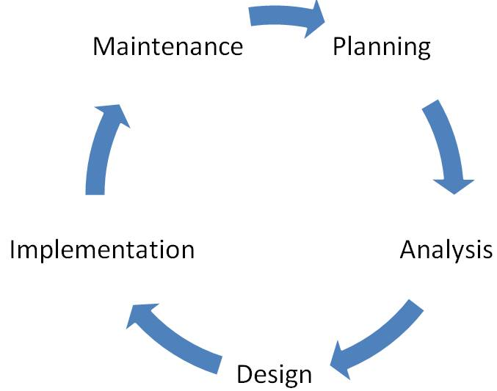
From Figure 1-8 Database Development Activities During the S D L C

Slide 22
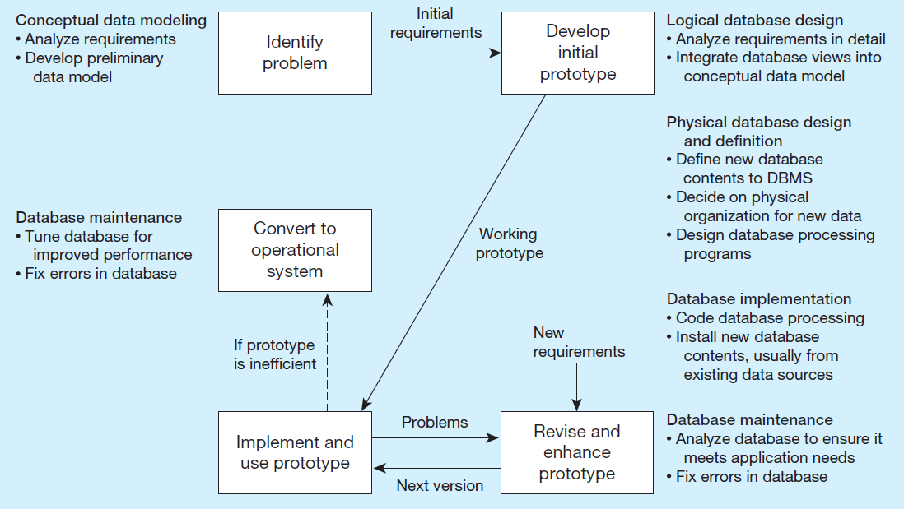
Figure 1-9 The Prototyping Methodology and Database Development Process

Slide 23
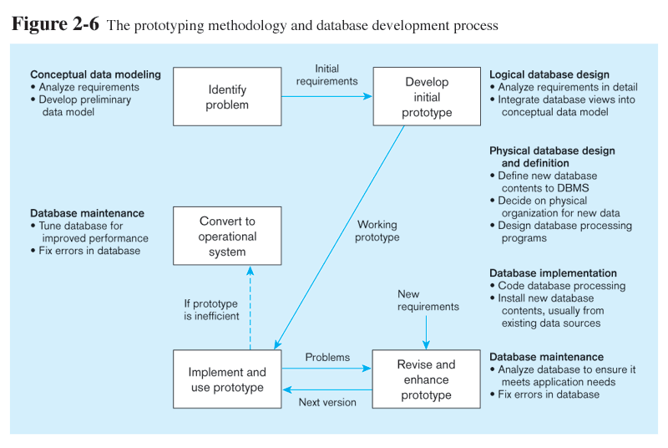
Figure 1-9 The Prototyping Methodology and Database Development Process
Prototyping is a classical Rapid Application Development (RAD) approach

Slide 24
Figure 1-9 The Prototyping Methodology and Database Development Process

Slide 25
Figure 1-9 The Prototyping Methodology and Database Development Process

Slide 26
Figure 1-9 The Prototyping Methodology and Database Development Process

Slide 27
Figure 1-9 The Prototyping Methodology and Database Development Process

Slide 28
Database Schema
External Schema
User Views
Subsets of Conceptual Schema
Can be determined from business-function/data entity matrices
DBA determines schema for different users
Conceptual Schema
E-R models–covered in Chapters 2 and 3
Internal Schema
Logical structures–covered in Chapter 4
Physical structures–covered in Chapter 8

Slide 29
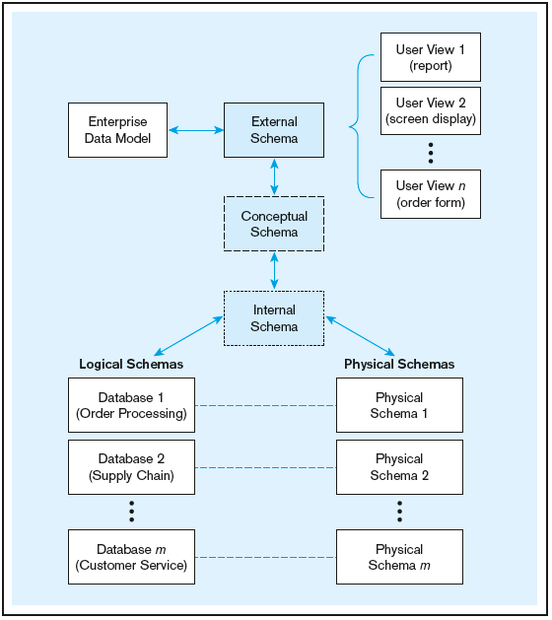
Figure 1-10 Three-schema architecture
Different people have different views of the database…these are the external schema
The internal schema is the underlying design and implementation

Slide 30
Managing People Involved in Database Development
Project – a planned undertaking of related activities to reach an objective that has a beginning and an end
Initiated and planned in planning stage of S D L C
Executed during analysis, design, and implementation
Closed at the end of implementation

Slide 31
Database Project Team Members (1 of 2)
Business analysts – analyze business situation and establish requirements
Systems analysts – like business analysts, but also have technical expertise for overall information systems
Database analysts and data modelers – analysts who focus on database
Users – the “customers” communicate their needs to analysts
Programmers – coders of the programs that interact with the database

Slide 32
Database Project Team Members (2 of 2)
Database architects – establish standards for data in business units
Data administrators – responsible for existing databases, ensuring data integrity and consistency
Project managers – oversee the projects, manage the personnel
Other technical experts – network, operating system, documentation, etc.

Slide 33
Motivations of Database Systems
Driven by four main objectives:
Need for program-data independence in order to reduce maintenance
Desire to manage more complex data types and structures
Ease of data access for less technical personnel
Need for more powerful decision support platforms

Slide 34
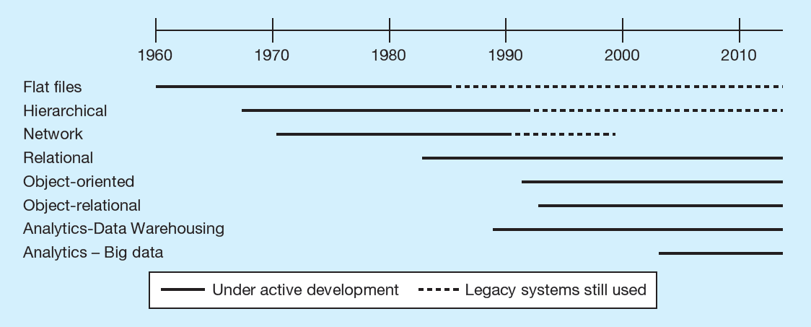
Figure 1-11 The Range of Database Technologies: Past and Present (1 of 4)
(a) Evolution of database technologies

Slide 35
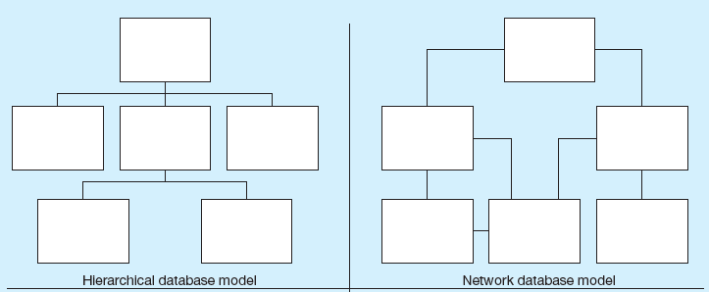
Figure 1-11 The Range of Database Technologies: Past and Present (2 of 4)
(b) Database architectures

Slide 36
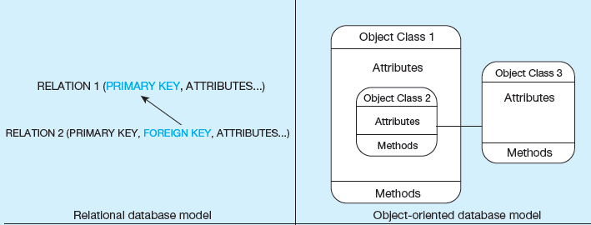
Figure 1-11 The Range of Database Technologies: Past and Present (3 of 4)
(b) Database architectures

Slide 37
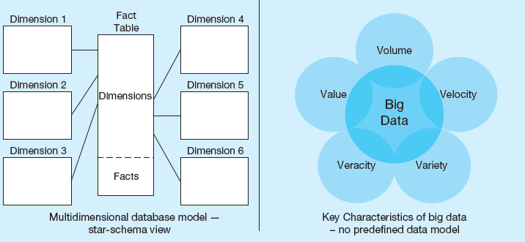
Figure 1-11 The Range of Database Technologies: Past and Present (4 of 4)
(b) Database architectures

Slide 38
The Range of Database Applications
Personal Databases
Typical size in the megabytes
Intended for one user
Departmental Multi-Tiered Client/Server Databases
Typical size in the gigabytes
Intended for several users, usually doesn’t exceed 100, department-wide
Enterprise Applications
Typical size in the gigabytes, terabytes, or even petabytes
Intended for a very large user base, company wide

Slide 39
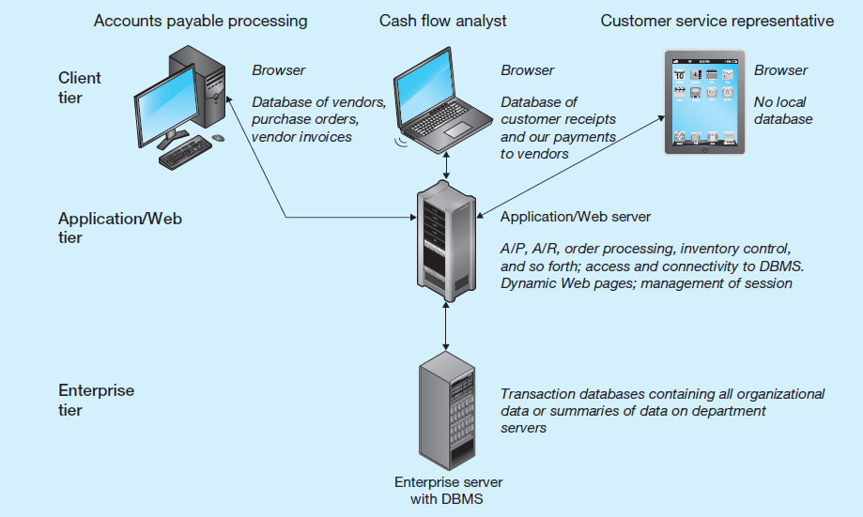
Figure 1-12 Multi-Tiered Client/Server Database Architecture

Slide 40
Types of Enterprise Applications
Enterprise Systems (typically involve relational databases)
Backbone of an organization
Enterprise resource planning (E R P)
Customer relationship management
Supply chain management
Human resource management and payroll
Data Warehouses (typically involve relational databases)
Integrates data from multiple data sources
Maintain historical data
Help identify patterns and trends
Data Lakes (often don’t involve relational databases)
Large integrated repository for internal and external data that does not follow a predefined schema

Slide 41
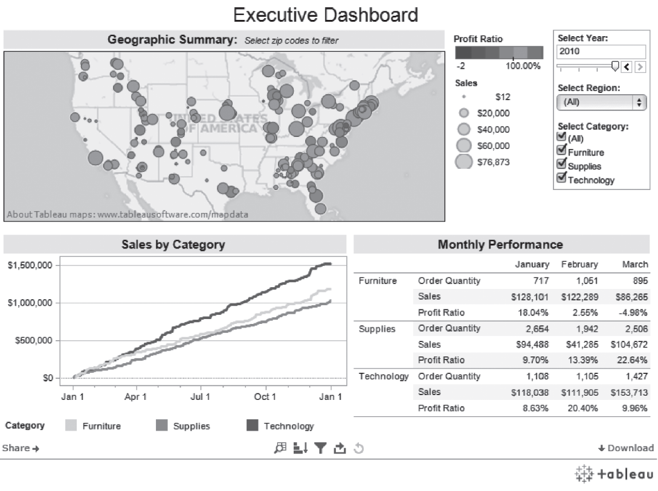
Figure 1-13 An Example of an Executive Dashboard
Dashboard
An integrated decision support database whose content is derived from the various operational databases.
An operational database is a database instance that creates or updates large amounts of data in real time.
(http://public.tableausoftware.com/profile/mirandali#!/vizhome/Executive-Dashboard_7/ExecutiveDashboard)
Courtesy Tableau Software

Slide 42
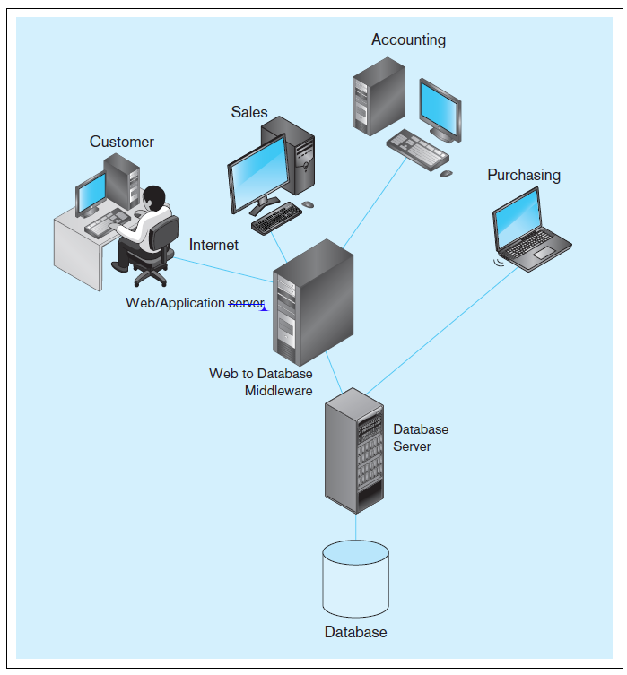
Pine Valley Furniture
P V F is a fictional furniture company
Will be used as a case throughout the book
FIGURE 1-14 Computer
System for Pine Valley
Furniture Company

Slide 43

Copyright

